Slide 1
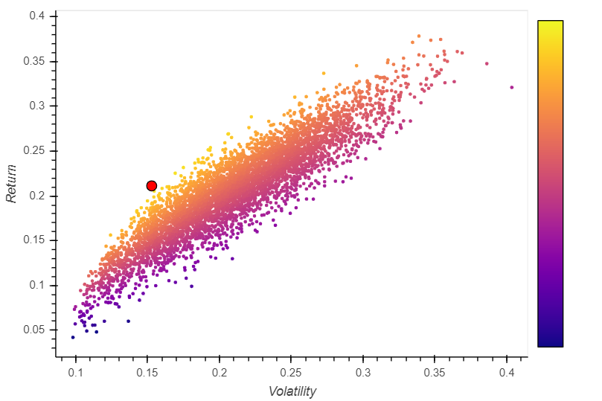
Sharpe Portfolio – Total Data

Slide 2
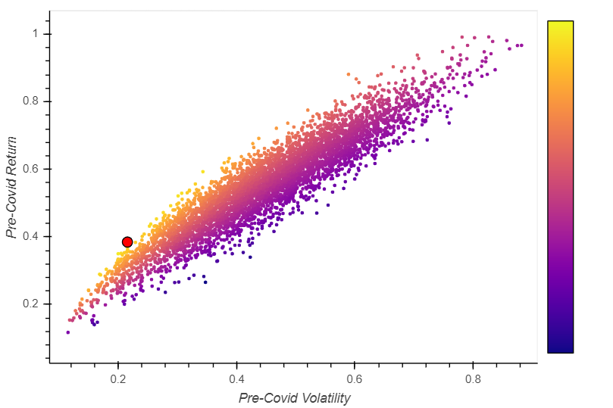
Sharpe Portfolio – PreCovid

Slide 3
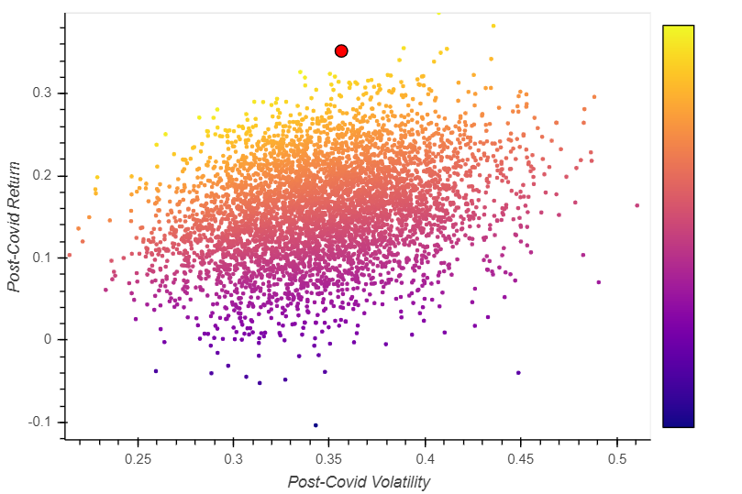
Sharpe Portfolio – PostCovid

Slide 4
Asset Class Type | # | Asset Ticker | Optimum Portfolio %
 |  |  | Total | Pre-Covid | Post-Covid
S&P 500 | 1 | SPY | 8.32 | 2.62 | 3.41
Stocks | 2 | AMZN | 13.60 | 12.40 | 12.01
 | 3 | LUV | 3.33 | 12.06 | 3.03
 | 4 | PFE | 9.77 | 9.62 | 6.89
 | 5 | AAPL | 13.99 | 13.12 | 11.24
Crypto | 6 | BTC | 13.12 | 6.81 | 4.12
 | 7 | ETH | 2.16 | 1.80 | 15.89
 | 8 | LTC | 0.20 | 0.66 | 1.14
Commodities | 9 | Corn | 6.10 | 6.93 | 5.38
 | 10 | Soybeans | 2.89 | 0.05 | 14.22
 | 11 | Wheat | 2.53 | 5.85 | 1.49
Metals | 12 | Gold | 9.59 | 13.43 | 6.91
 | 13 | Silver | 12.84 | 11.06 | 11.58
 | 14 | Platinum | 1.56 | 3.59 | 2.67

Slide 5
